Slide 1
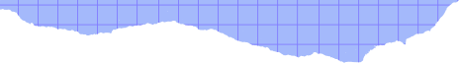




DATA STRUCTURES AND ALGORTHM

Slide 2
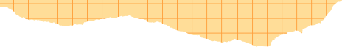




INDEX
QUESTION
ALGORITHM
WHY QUEUE?
TIME COMPLEXITY
SPACE COMPLEXITY
CODE

Slide 3

ENTRY QUEUE MANAGER
You need to build an entry queue manager for a stadium. There are N entry gates.
As people keep coming in, they can line up in any of the queues or switch queues
anytime if they think that will get them a quicker entry. The entry queue manager
helps them in making that decision by suggesting (i) the time for the last person
in the queue to enter through any gate (assume that it takes p mins to enter any
gate), (ii) the particular queue number(s) in the line who should be switching. The
queue manager must be designed to minimize the time for M people to enter the
stadium. Each gate has an initial random assignment of M/2 people (a gate may
not have anyone assigned).

Slide 4
STEP 1 : INITIALIZING
STEP 3:RANDOM NO GENEREATION
Set switchCount to 0.
Set maxIterations to a predefined maximum number of iterations (e.g., 10000).
Create an array of queues queues with N elements, each representing a queue.
For i from 0 to M / 2 - 1:
Generate a random number queueNumber between 0 and N - 1.
Enqueue person i + 1 into the queue at index queueNumber.
ALGORITHM
STEP 2:TAKE INPUT
STEP 4 : INTIALIZE QUEUE TIME
Read the total number of persons M.
Read the total number of queues N.
Read the time to pass through the gate p .
For each queue i from 0 to N - 1:
Print "Queue i + 1: Time taken by queue i + 1 to pass through gate".

Slide 5
STEP 5 : MAIN FUNCTION
STEP 7:OUTPUT
While not all queues have the same number of persons and switchCount is less than maxIterations, Then
Find the queue with the maximum time taken to pass through the gate and the queue with the minimum time taken .
If the difference between the maximum and minimum times is less than or equal to p, break the loop.
Otherwise, switch a person from the queue with maxQueueIndex to the queue with minQueueIndex.
Increment switchCount.
Print "Switch switchCount: Person from Queue maxQueueIndex + 1 moved to Queue minQueueIndex + 1".
Output:
Print "Total number of switches: switchCount".
ALGORITHM
STEP 6: FINAL TIME DISPLAY
STEP 8: SET THE MEMORY FREE
For each queue i from 0 to N - 1:
Print "Queue i + 1: Time taken by queue i + 1 to pass through gate after switching".
Free memory allocated for the array of queues queues.

Slide 6

WHY WE CHOOSE
“QUEUE” AS OUR DATA STRUCTURE??
FIFO
MAINTAINS ORDER
This feature of queue i.e. First in First out makes it very convenient for us to make the an entry. As the items are inserted at the end of the queue and removed from the front. The first item to be inserted is the first to be removed.
.It maintains the order in which elements are inserted which makes it easy for us to
ENQUEUE
DEQUEUE
When you enqueue something, you're adding it to the end of the line. It's like joining the back of the queue.
Dequeuing is another essential operation in a queue, and it's like taking something out of the line. When you dequeue, you’re removing the first item that was added to the queue.

Slide 7
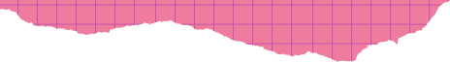


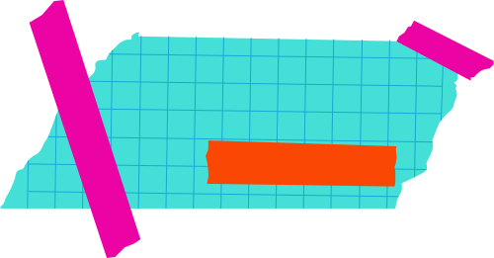
TIME COMPLEXITY
1.FOR INITIALIZING QUEUE
2.POPULATING QUEUES:
3.INITIALIZING QUEUE TIMING :
4.FOR THE MAIN FUNCTION:
Initializing the array of queues takes O(N) time.
Populating the queues with persons takes O(M) time, where M is the total number of persons.
Printing the initial queue times takes O(N) time.
The time complexity of the main loop is
O(N * maxIterations).
5.THE FINAL QUEUE TIME:
Overall Time Complexity:
t factor in the time complexity is the main loop, which is O(N * maxIterations).
In the worst case, if maxIterations is proportional to the size of the input (M), the overall time complexity can be approximated as O(N * M).
Printing the final queue times takes O(N) time.

Slide 8
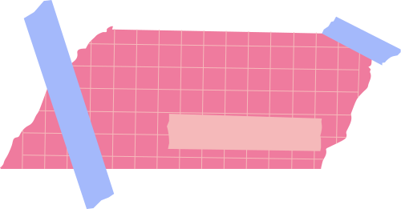




SPACE
COMPLEXITY
Queue Array: The array occupies O(N) space, where N is the total number of queues.
Random Number Generator: The Random class uses a single unsigned long long variable (s) for state, which requires a constant amount of space. i.e 0(1)
Node Structure: . Assuming an integer and a pointer each occupy a constant amount of space, the space required for each node is constant.
Queues:
Therefore, the total space required for all queues is O(M), where M is the total number of persons. i.e 0(1)
The overall space complexity of the given code is O(N + M), where N is the total number of queues and M is the total number of persons.
Other Variables: Other variables like switchCount, maxIterations, M, N, and p require a constant amount of space. i.e 0(1)

Slide 9
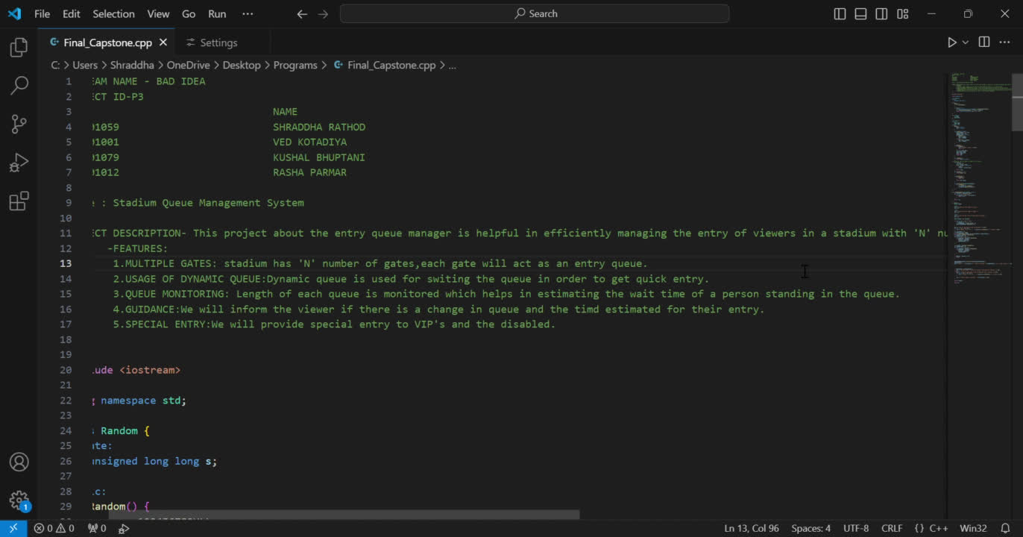
CODE:

